Slide 1

Presentation On Cartooning an Image Using Open CV and Python
Group No. 23
Submitted By: Rahul Kumar
Rekha Rani
Shubhranshu Yadav

Slide 2
Table Of Contents
Introduction
HARDWARE/ SOFTWARE REQUIREMENT
System Design
Flow-chart
Implementation
Conclusion
References

Slide 3
Introduction
Currently, there are many applications available in the market that can cartoonify an image. But what if we can make our own? So today we’re going to make our own image cartoonizer using OpenCV & Python.
Image cartoon frames don’t contain so many variants of color and those frames also contain dark edges of each object. There’re lots of ways to do that, but we’re going to use color quantization and the adaptive threshold technique. Using this technique we can achieve a very great result.

Slide 4
HARDWARE/ SOFTWARE REQUIREMENT
Hardware–
On Smart Phone
Processor should be dual core.
Processor speed be 1.3 GHz.
ROM 1 GB.
RAM 512 MB.
On Personal Computer (PC)
Processor should be dual core.
Processor speed be 1.5 GHz.
RAM more than 4 GB.
ROM more than 30 GB.
Software–
Visual Studio Code.
Python

Slide 5
System Design
System design is the solution of a “how to approach to the creation of the new system. It is composed of several steps. It facilitates the understanding and provides the procedural details necessary for implementation of the system recommended in the feasibility study. Emphasis is given on translating the performance requirements into design specification. Design goes through logical and physical stages of development.
Logical design reviews the present physical system; prepares input and output specification; make editing; security and control specification; details the implementation plan, and prepare logical design walk through. The physical design maps out the details of the physical system; plans the system implementation plan and specifies hardware and software. System design translates the system requirement into the ways of the system as recommended in the feasibility study

Slide 6
Flow-Chart
Flowchart is a graphical representation of an algorithm. Programmers often use it as a program-planning tool to solve a problem. It makes use of symbols which are connected among them to indicate the flow of information and processing. The process of drawing a flowchart for an algorithm is known as “flow charting”.

Slide 7
Basic Symbols used in Flowchart Designs
Terminal: The oval symbol indicates Start, Stop and Halt in a program’s logic flow. A pause/halt is generally used in a program logic under some error conditions. Terminal is the first and last symbols in the flowchart.
Input/Output:A parallelogram denotes any function of input/output type. Program instructions that take input from input devices and display output on output devices are indicated with parallelogram in a flowchart.
Processing: A box represents arithmetic instructions. All arithmetic processes such as adding, subtracting, multiplication and division are indicated by action or process symbol.
Decision: Diamond symbol represents a decision point. Decision based operations such as yes/no question or true/false are indicated by diamond in flowchart.
Connectors: Whenever flowchart becomes complex or it spreads over more than one page, it is useful to use connectors to avoid any confusions. It is represented by a circle.
Flow lines: Flow lines indicate the exact sequence in which instructions are executed. Arrows represent the direction of flow of control and relationship among different symbols of flowchart.

Slide 8
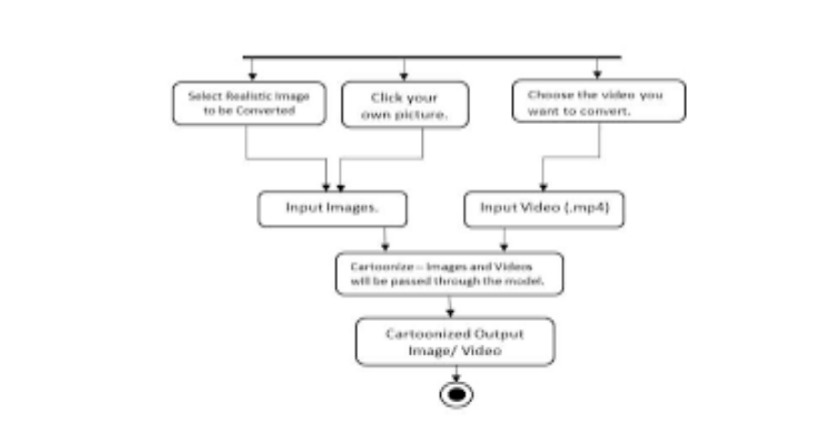

Slide 9
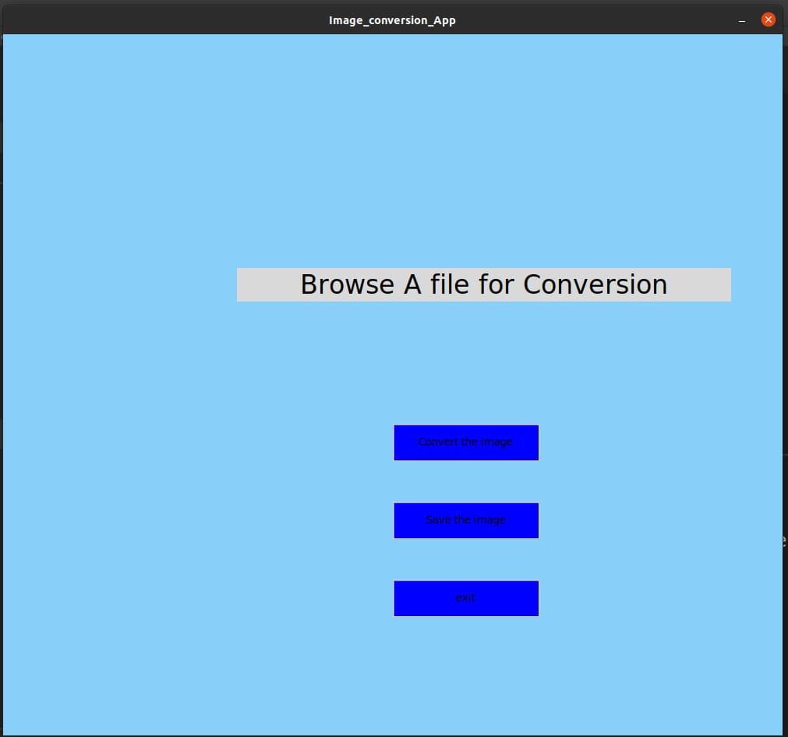
IMPLEMENTATION

Slide 10
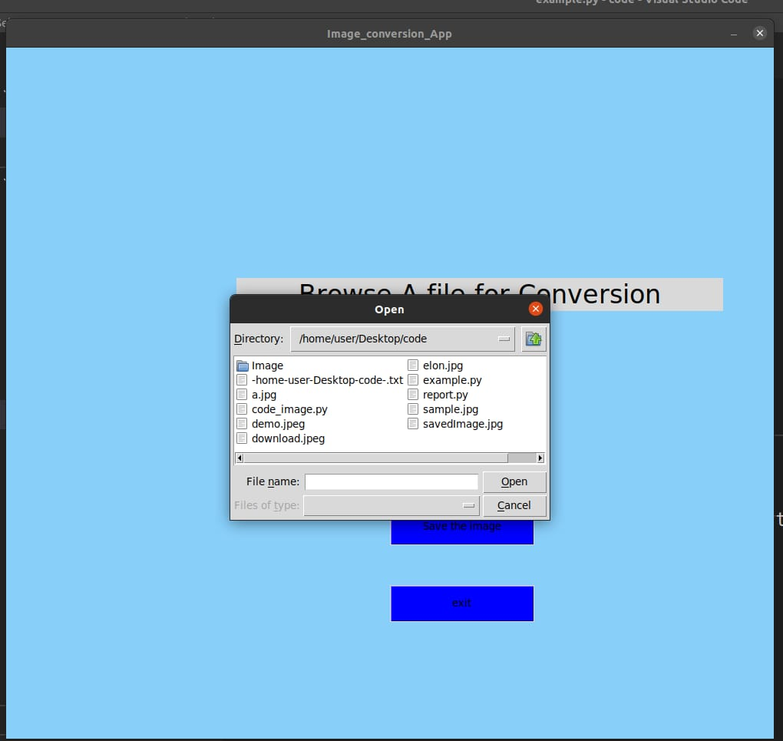
Open The Image Button

Slide 11
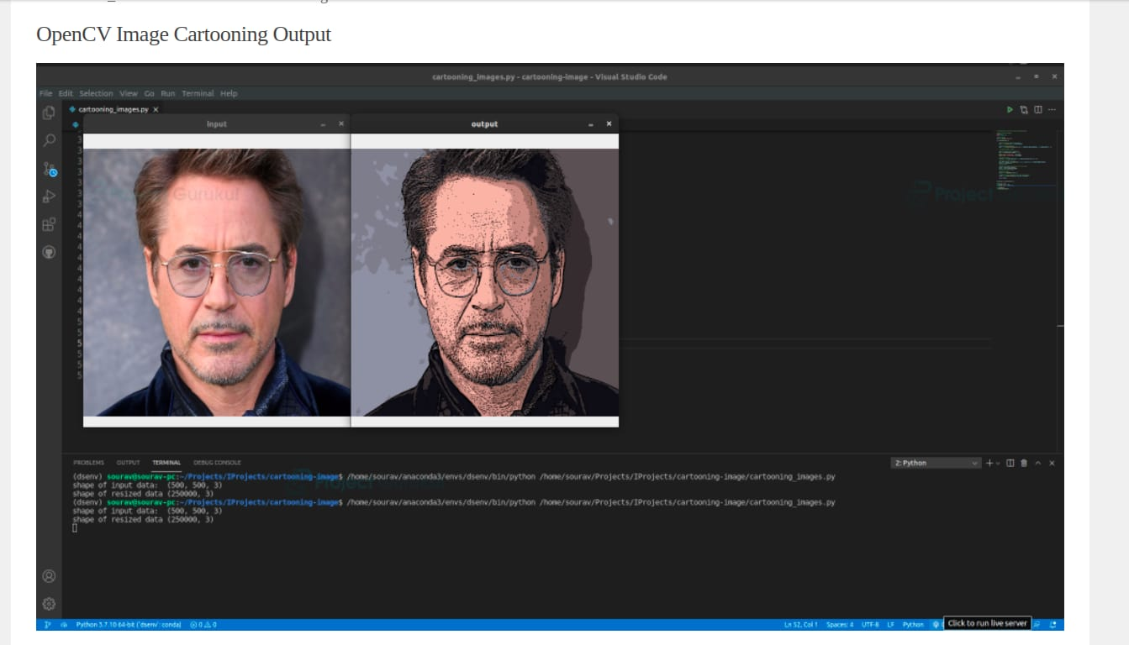
Output Image

Slide 12
CONCLUSION
First of all, the basic tools to handle the titled problems of the thesis are incorporated. It includes origin and history of image processing, different types of uncertain environment, existing methods for cartoon imaging. Amid the previous three decades, the topic of image processing has gained vital name and recognition among researchers because of their frequent look in varied and widespread applications within the field of various branches of science and engineering.
As an example, image processing is helpful to issues in signature recognition, digital video processing, Remote Sensing and finance. Conclusion and Future Directions Firstly, we use high-resolution camera to take picture of the internal structure of the wire. Secondly, we use Open-CV image processing functions to implement image preprocessing. Thirdly we use morphological opening and closing operations to segment image because of their blur image edges. The main attraction of the paper is to solve different types of images having one object, two object and three object which can’t be solved by any of the exiting methods but can be solved by our proposed method.

Slide 13
REFERENCES
[1] Yi Yang, Yueting Zhuang, Dacheng Tao, Dong Xu, Jun Yu, and Jiebo Luo; "Recognizing Cartoon Image Gestures for Retrieval and Interactive Cartoon Clip Synthesis", IEEE Transactions On Circuits And Systems For Video Technology, Vol. 20, No. 12, Pp. 1745-1756, December 2010
[2] Zhang Liang,Yueting Zhuang , Yi Yang and Jun Xiao; "Retrieval-Based Cartoon Gesture Recognition and Applications Via Semi-Supervised Heterogeneous Classifiers Learning ", Pattern Recognition, 2013
[3] Sungyoung Kim, Soyoun Park, and Minhwan Kim; "Central Object Extraction for Object-Based Image Retrieval", E. M. Bakker et al. (Eds.): CIVR 2003, LNCS 2728, Pp. 39-49, 2003.
[4] Yi Yang, Yueting Zhuang, Dong Xu, Yunhe Pan, Dacheng Tao and Steve Maybank; " Retrieval Based Interactive Cartoon Synthesis via Unsupervised Bi-Distance Metric Learning", MM’09, Beijing, China, Pp. 311-320, 2009.
[5] Savitha Sivan and Thusnavis Bella Mary; "An Optimized Feature Extraction Technique for Content Based Image Retrieval", International Journal of Image Processing and Vision Sciences (IJIPVS), Pp. 35-40, 2013
[6] Saikrishna, Yesubabu, Anandarao, Sudha Rani; "A Novel Image Retrieval Method Using Segmentation and Color Moments", Advanced Computing: An International Journal (ACIJ), Vol.3, No.1, Pp. 75-80, 2012. .

Slide 14
REFERENCES
[7] Miki Haseyama and Atsushi Matsumura; "A Cartoon Character Retrieval System Including Trainable Scheme", in Proc. ICIP, Pp. 37–40, Sep. 2003
[8] Miki Haseyama and Atsushi Matsumura; "A Trainable Retrieval System For Cartoon Character Images", in Proc. ICME, Pp. 393–396, Jul. 2003.
. [9] Ahmed Talib, Massudi Mahmuddin, Husniza Husni and Loay E. George; "A Weighted Dominant Color Descriptor for Content-Based Image Retrieval", J. Vis. Commun. Image R., (Elsevier), Pp. 345-360, 2013. Mustafa M. Abd Zaid et al, International Journal of Computer Science and Mobile Computing, Vol.3 Issue.12, December- 2014, pg. 482-491 © 2014, IJCSMC All Rights Reserved 491
[10] Ruggero Milanese; "Detecting Salient Regions in an Image: from Biological Evidence to Computer Implementation", Ph.D. Thesis, University of Geneva, 1993.
[11] Jun Yu and Seah; "Fuzzy Diffusion Distance Learning for Cartoon Similarity Estimation", Journal of Computer Science and Technology, Vol. 26, No. 2, Pp. 203-216, 2011.
[ 12] Jun Yu, Jun Cheng and Dacheng Tao; "Interactive Cartoon Reusing by Transfer Learning", J. Signal Process, Vol. 92, Pp. 2147–2158, 2012.

Slide 15

Thank you

